Slide 1

School District No. 8 (Kootenay Lake)

Slide 2
We acknowledge, respect and honour the First Nations in whose traditional territories the Kootenay Lake School District operates and all Indigenous people residing within the boundaries of School District 8.

Slide 3
SD8 Vision, Mission, Values
Our Vision: Our learners grow as global citizens in an innovative and inclusive community.
Our Mission: We inspire and support each learner to thrive in a caring learning environment.

Slide 4
SD8 Vision, Mission, Values
Our Values:
Learners at the Centre
We support a culture of empathy, mutual respect, and shared responsibility through individual and shared purpose. We provide meaningful and relevant learning experiences with opportunities for growth and improvement.
Communities of caring and connection
We build trusting, respectful, collaborative relationships working together to ensure we make the best decisions. We foster opportunities to promote social-emotional and physical well-being for all students and staff and celebrate our success

Slide 5
SD8 Vision, Mission, Values
Our Values:
Diversity and Identity
We meaningfully and equitably involve all learners and respect the unique characteristics and identities that make them individuals. Barriers are removed to create equitable environments that provide accessible and empowering opportunities for all students and staff to thrive. Truth and Reconciliation create our path forward to respect the human rights of Indigenous Peoples.
Caring for the Future
We are stewards of the future who foster lifelong learning and creative, curious, resilient global citizens to contribute to a diverse, inclusive, and sustainable society.

Slide 6
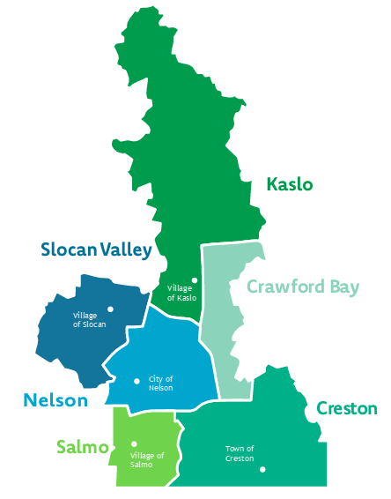
About our District
6 Families of Schools:
6 20
Municipalities schools
900 4800
Employees students
1
blended online learning school
1
provincial online learning school
15,000 15+ Square kilometers rural communities
Two Unions:
Kootenay Lake Teachers Federation (KLTF) – teachers
Canadian Union of Public Employees 748 (CUPE) – support staff (bus driver’s, custodian’s, EA’s, Secretary’s, trades etc.)

Slide 7
Human Resource Services
We value…
Integrity: Treat each employee with dignity, respect, honesty, and trust;
Teamwork: Promote and celebrate effective communication, collaboration, and success;
Well-being: Promote employee well-being by offering wellness initiatives and creating an agile workforce to manage change; and
Service Excellence: Anticipate, understand, and respond in a timely and effective manner to the needs of all our partners.

Slide 8
Human Resource Services Team
Chandra Singh – Director of Human Resources
  Chandra.singh@sd8.bc.ca
Theresa Montpellier – Manager of Human Resources
Theresa.montpellier@sd8.bc.ca
Scott Rothermel – Manager of Safe Schools & OHS
  safeschools@sd8.bc.ca
Chandra Moon – Executive Assistant
  Ea.hr@sd8.bc.ca

Slide 9
Human Resource Services Team
Melissa Maida – Human Resources Advisor
  Melissa.maida@sd8.bc.ca
Brittany Deuling – Human Resources Advisor
  Brittany.deuling@sd8.bc.ca
Autumn Clarke – Human Resources Services Clerical
  hrservices@sd8.bc.ca
Ellisha Macoretta – SFE Operator/Dispatch
  tabsence@sd8.bc.ca

Slide 10
Wellness Initiatives
Bike Purchase Program
Computer Purchase Program
Professional Development Funds (CUPE and KLTF and excluded staff)
TELUS Health – our Employee Family Assistance Program (EFAP) All employees and family members qualify. Visit www.sd8.bc.ca for more info
Pacific Blue Cross Benefits (0.50 FTE to qualify or 17.5 hrs/wk Regular position)
CUPE –Wellness Benefit

Slide 11

In 2022, LifeWorks joined forces with TELUS Health to support employers
around the globe with health and well-being solutions encompassing physical, mental, and financial health. Together, they’re combining world-leading digital and in-person health and wellbeing services to empower individuals to live their healthiest lives.
Since 2008, TELUS Health has strategically invested in building innovative capabilities that reimagine the way health is delivered and experienced. Today, at TELUS Health, we are uniquely positioned to drive remarkable health and well-being experiences for our customers and the individuals we serve around the world.
A transformational journey - LifeWorks becomes TELUS Health.
Financial
Knowledge, behavior, design, strategies, and insights that support financial security.
Physical
Lifestyle choices that support current and long-term health and physical ability.
Social
Strong social relationships that give people a sense of connection and belonging
Mental
Helping individuals realize their full potential, cope with daily stress and be productive.
Reimagining employee health and wellbeing.
Notes:
Found on the website on the top right hand corner of the website, under resources and then click EFAP

Slide 12
Training Overview- Respectful Workplace
• Workers Compensation Act
• Recognizing respectful workplace
• Employer obligations
• Worker and supervisor obligations
• Reporting procedures
• Investigating incidents or complaints
• What co-workers can do to create a respectful workplace
• Talking to a bully
Notes:
As an employee of the SD it is important that we follow the respectful workplace policy and regulations. In this training we will be reviewing the following.
Introductory slide: Briefly discuss the agenda:
Definitions of bullying and harassment and other key terms
Obligations of employers and employees under the Worker’s Compensation Act
Respectful Workplace Policy and regulations
How to submit a complaint
Who can help employees
Other provisions

Slide 13
Workers Compensation Act
Duties of employers, workers, and supervisors:
  Ensure or protect health and safety
  Includes workplace bullying and harassment
Occupational Health and Safety (OHS) policies on workplace bullying and harassment;
Training all employees annually;

Slide 14
Policy Statement
Policy 170.2.6 - Respectful Workplace
Administration Procedure 4001: Respectful Workplace Program
The Board of Education will not tolerate any conduct that could be classified as discrimination, harassment, sexual harassment or bullying, and will make every reasonable effort to ensure that no employee, student, parent, guardian, visitor, consultant, contractor, and volunteer is subjected to such behaviors.

Slide 15
Definition of Harassment
Harassment: For the purpose of this Policy, harassment shall be defined as including:
  Any improper behavior that is directed at or is offensive to any person and is unwelcome and which the person knows or ought reasonably to know would be unwelcome.
  Offensive conduct, comment, materials or displays made on either a one time or continuous basis that demeans, belittles, intimidates, or humiliates another person.
  The exercise of power or authority in a manner which serves no legitimate work purpose and which a person ought reasonably to know is inappropriate.
  Such misuses of power or authority that could reasonably be interpreted as intimidation, threats, or blackmail.

Slide 16
Definition of Bullying
Bullying:
  Bullying is verbal or physical behavior by one (1) or more people who appear to be more powerful in some way than their victim. Bullying makes the victim feel uncomfortable, embarrassed and/or unsafe and can interfere with the victim’s success at school or work.

Slide 17
Definition of Discrimination
Discrimination:
Discrimination is an action or a decision that treats a person or a group badly for reasons such as their race, age, gender, sexual orientation, or disability, These reasons, are also called grounds, are protected under the Canadian Human Rights Act.

Slide 18
Definition of Sexual Harassment
Sexual Harassment:
  Any comment, look, suggestion, physical contact or real or implied action of a sexual nature which creates an uncomfortable working environment for the recipient, made by a person who knows or ought reasonably to know such behavior is unwelcome.
  Any circulation or display of written or visual material of a sexual nature that has the effect of creating an uncomfortable learning or working environment.
  An implied promise of reward for complying with a request of a sexual nature.
  A sexual advance made by a person that includes or implies a threat or an expressed or implied denial of an opportunity which would otherwise be granted or available and may include reprisal or a threat of reprisal made after a sexual advance is rejected.

Slide 19
Examples of Discrimination, Harassment and Bullying
Specific examples of harassment, sexual harassment, bullying: Sexual or personal harassment may include, but is not limited to behaviors, whether intentional or unintentional, which are perceived by the recipient as unwelcome. Examples of such behaviors include, but are not limited to:
  Remarks or correspondence with sexual overtones
  Jokes that cause awkwardness or embarrassment
  Innuendoes, taunting or intimidation, based on one’s real or perceived identity
  Gender-based, gender identity or sexual orientation-based remarks of a derogatory or sexual nature, or general insulting remarks
  Proposal of the intimacy of a sexual nature
  Repeated unwelcome invitations, request for dates or sexual favors
  Leering, patting, pinching, touching, hugging, brushing against

Slide 20
Continuation of examples of harassment, sexual harassment & bullying
  Displays of materials, pictures, cartoons or sayings of a derogatory, sexist, homophobic transphobic, racist, pornographic or otherwise demeaning nature
  Calling someone names
  Spreading rumors
  Stealing or extorting someone’s lunch or other property
  Vandalizing District and/or personal belongings
  Exclusion from groups
  Unfair treatment, comments or bias against someone or a group of people based on their race

Slide 21
What is not discrimination or Harassment
Expressing differences of opinion
Offering constructive feedback
Making a legitimate complaint about another worker’s conduct
Reasonable management action, including decisions about:
  Job duties and work to be performed
  Workloads and deadlines
  Layoffs, transfers, promotions, and reorganizations
  Work instruction, supervision, or feedback
  Work evaluation
  Performance management
  Discipline, suspensions, or terminations
4.1. an occasional compliment
4.2. flirtation or banter when it is mutually acceptable between/among peers or friends
4.3. normal exercise of supervisory responsibilities, including disciplining, when warranted.
Notes:
Expressing a difference of opinion, offering constructive feedback or advice about work-related behaviour or performance, and making a legitimate complaint through established procedures about a manager’s or another worker’s conduct are not considered bullying and harassment.
It’s also important to note that reasonable management action is not considered workplace bullying and harassment. Managers and supervisors have many responsibilities — including directing and supervising how work is performed, monitoring workflow, and providing feedback on performance. As long as those actions are taken in a respectful manner, they do not constitute bullying and harassment.
Reasonable management action might include decisions relating to:
Job duties and/or work to be performed
Workloads and deadlines
Layoffs, transfers, promotions, and reorganizations
Work instruction, supervision, or feedback
Work evaluation
Performance management, or
Discipline, suspensions, or terminations

Slide 22
Effects and potential indicators
Workplace bullying and harassment might result in:
Health and safety issues
Distracting someone who is performing dangerous tasks
Physical and/or psychological injury
Lower productivity
Lower morale
Staff turnover

Slide 23
Employer obligations
Prevent or minimize bullying and harassment
Develop reporting procedures
Develop procedures for dealing with
investigating incidents or complaints
Train workers and supervisors
Notes:
Everyone in the workplace has a role to play when it comes to preventing and addressing bullying and harassment. Under WorkSafe BC regulation, employers, workers, and supervisors have a number of legal duties.
Employers must:
Have a policy statement that workplace bullying is unacceptable and not tolerated. In School District 8, this is policy No. 580.
Take steps to prevent or minimize workplace bullying and harassment
Have procedures for employees to report if they feel bullied and harassed, including how to report if the employer or supervisor is the alleged bully
Have procedures that explain how our organization deals with bullying and harassment incidents or complaints. In School District 8, these are Regulations 580 and 580.1 in AP
Provide training about bullying and harassment to workers and supervisors, which is why we’re here today

Slide 24
Prevent or minimize
Take steps to prevent or minimize bullying and harassment
Have a procedure for informal resolution of a complaint
Complainants are encouraged, but not required, immediately tell the other person when their behavior is considered inappropriate and unwanted and ask that the unwanted conduct stop.
Persons should comply immediately with the request without retaliation.
If the complaint is not resolved the following procedures should be followed:
5.1 Procedures for teachers -
  Complaints involving teachers will be subject to the provisions of the
Collective Agreement with the employer.
5.2 Procedures for C.U.P.E. Employees -
  Complaints involving C.U.P.E. members will be subject to the provisions of the Collective Agreement with the employer.

Slide 25
Employee Obligations
All employees have the right to:
Make complaints (note: Teachers’ Code of Ethics does NOT apply in harassment cases)
To read and understand Employee Code Of Conduct - AP 4000
Be informed of complaints against them
A fair hearing
A full investigation
Confidentiality
Choose a representative of their choice

Slide 26
Informal Resolution Process
  Informal resolution process of bullying/harassment is subject to provisions of relevant Collective Agreements, District policy and administrative procedures:
KLTF:
  Provincial Article E2
CUPE
  Article 4.04
District Policy and Administrative Procedure -
  Policy – 170.2 – Respectful Workplace
  AP 4001 – Respectful Workplace Program

Slide 27
TIPS
If you feel you are being subject to harassment, or if harassment is reported to you, DOCUMENT with specific information.
Ask for help – talk to an administrator, senior leadership person, Director of Human Resources, Human Resources staff, your union representative, an identified harassment investigator, etc.
Do not ignore the complaint & ask for help if you are unsure if it is bullying/harassment.
Read the relevant sections of the Collective Agreements and SD8 Policy – Administrative Procedures.
You may also ask for advice from one of the District’s Harassment Investigators – please contact Chandra Singh – Director of Human Resources.

Slide 28
Dealing with incidents or complaints
Investigations are conducted as soon as possible but they may take a long time to finish, depending on the circumstances.
If an external investigator needs to be contracted, investigations may take longer to initiate.
District is responsible for investigating complaints, following proper procedures, keeping the investigation confidential, reporting to the complainant and respondent after the investigation is complete, determining actions, and keeping records confidential.
Notes:
When human resources receives a complaint the following may occur:
A determination is made regarding whether the unwanted behavior is bullying or harassment – the complaint may not reach the threshold of bullying and harassment.
Human Resources would ask for more details – there may not be enough information to initiate an investigation and in that case,
An informal resolution may be suggested – examples could be mediation due to ongoing interpersonal conflict if agreed upon by complainant and respondent
An Investigation may be initiated to determine if bullying and harassment has occurred

Slide 29
What must workers do?
Report if they observe or experience bullying and harassment.
Reporting Procedure:
  Every employee is required to report incidents of bullying/harassment.
  Report to your direct management supervisor (eg: principal, site supervisor).
  If the employer or supervisor is the alleged bully, then report to the Director of Human Resources and/or to a union representative.
  You should report in writing – you may report by email, by letter, or by other written communique.
Not engage in workplace bullying and harassment.
Apply and comply with workplace policies and procedures on respectful workplace.

Slide 30
What must supervisors do?
Document all complaints and report to the Director of Human Resources
Not engage in bullying and harassment.
Apply and comply with workplace policies and procedures on respectful workplace

Slide 31
What can co-workers do to support a respectful workplace?
Listen to the target
Don’t gossip
Offer support (e.g., employee assistance program, counselor)
Document details of what you see to share in an investigation
– Dates
– Details
– Witnesses
Tell the bully to stop

Slide 32
Talking to an alleged bully
If you are the target of or witness to, bullying and harassment:
– Tell the bully what behavior was inappropriate
– Make it clear the behavior is unwanted and unacceptable
– Stay calm
– Don’t retaliate
– Report it

Slide 33
Related Documents
B.C. Human Rights Code
Workers’ Compensation Act Legislation and Regulations
BCTF Collective Agreements (both provincial and local)
CUPE Collective Agreement
SD#8 Admin Procedures 4001 Respectful Workplace Program

Slide 34
For more information
School District #8 policies and procedures can be found at http://www.sd8.bc.ca/Policy/
For more information, contact our respectful workplace representative at Chandra.singh@sd8.bc.ca
For more tips, resources and information, visit:
https://www.worksafebc.com/en/health-safety/hazards-exposures/bullying-harassment

Slide 35
Cultural Safety
What is Cultural Safety?
Cultural Safety¹ involves the creation of space for everyone, regardless of their culture and heritage to feel welcomed as participants in respectful dialogue that values and acknowledges diverse perspectives and views. Cultural safety allows everyone to feel they can safely raise concerns and have their perspectives respected.
https://www.sd8.bc.ca/sites/default/files/documents/2022-09/331%20Antiracism%20and%20Cultural%20Safety%20%20%282022.06.21%29.pdf
https://www.indigenoushealthnh.ca/sites/default/files/2017-03/booklet-cultural-safety-web_0.pdf

Slide 36
Cultural Humility
What is Cultural Humility?
Cultural Humility² is a way of engaging in self-reflection about one’s own beliefs, understandings, and assumptions in order to better understand how to accept and recognize diverse ways of being in the world. Cultural humility seeks to create spaces for different and sometimes competing perspectives and doesn’t assume there is only one way to know/be in the world. It is a lifelong process of learning and involves a commitment to being open to learning about others.
https://www.sd8.bc.ca/sites/default/files/documents/2022-09/331%20Antiracism%20and%20Cultural%20Safety%20%20%282022.06.21%29.pdf
https://www.indigenoushealthnh.ca/sites/default/files/2017-03/booklet-cultural-safety-web_0.pdf

Slide 37
Why is it important?
The legacies of racist practices within the Canadian education system are still felt today and SD8 is working to address these inequities that have resulted from such practices.
As per SD8’s Anti-Racism and Cultural Safety Administrative Procedure # 4002: “The Board of Education commits to addressing all educational recommendations in the Truth and Reconciliation Commission Report and to the implementation of the Declaration on the Rights of Indigenous Peoples Act (DRIPA BC Implementation Plan).”
The work that we collectively do as staff supporting students is fundamental in moving this forward so that students have a supported and safe experience at school. As SD8 staff, we all have a role to play in this work.

Slide 38
What does Cultural Safety look like in SD8?
Some examples of Cultural Safety in education include:
Understanding it starts with each of us, individually!
Learning from cultural communities and engaging in personal reflection and critical thinking
Exploring our own values, assumptions, biases, and worldviews
Strengthening relationships with communities and becoming involved when appropriate
Ensuring physical environments reflect the identities of cultural communities
Increasing staff knowledge about what education and traditional knowledge transfer practices look like for cultural communities

Slide 39
How can staff put this into action?
Do something – Go beyond good intentions and take action for change. Speak up and out against racism and ask questions of those with more understanding. Create relationships with allies and lean into support systems as this work should not be done alone.
Initiate your own learning. Read, reflect, and ask questions. Do not expect this learning to come from people of cultural communities.
Self-reflect. Become self-aware of your own assumptions and biases. Question everything you have ‘learned’ and take steps to actively disrupt the beliefs.
Commit to lifelong learning. Get uncomfortable. Understanding colonialism and the legacy of racism is an ongoing and difficult task. Find support when you need it.
Adapted from: https://www.heretohelp.bc.ca/visions/indigenous-people-vol11/what-indigenous-cultural-safety-and-why-should-i-care-about-it

Slide 40
Resources for Additional
Learning
Anti-Racism: A Guide for Teachers (Ministry of Education and Child Care)
What is Cultural Safety and Why Should I Care About it? (Here to Help)
Cultural Competency and Cultural Safety Toolkit (Saskatoon Health Region)
Adapted from: https://www.heretohelp.bc.ca/visions/indigenous-people-vol11/what-indigenous-cultural-safety-and-why-should-i-care-about-it

Slide 41
Duty of Care
Scott Rothermel (he/him/his)
Manager of Safe Schools & OHS
Notes:
Updated June 2020

Slide 42
Expected Duty and Standard of Care in School Settings
The common law in Canada clearly establishes that school authorities have a special duty of care towards students in their charge.
This duty is imposed upon us by the unique nature of our work. Because parents are obligated to either send their children to school or provide home schooling, they are entitled to expect that schools will take reasonable measures to prevent risks of harm within the school environment or on school-sponsored excursions.

Slide 43
Learning Objectives
Expected Duty and Standard of Care in School Settings
Expectations related to District Policy and Procedure
Duty to Report Child Abuse and Neglect to MCFD

Slide 44
DUTY TO REPORT – Ministry of Children and Family Development
The Child, Family and Community Service Act requires that anyone who has reason to believe that a child or youth needs protection under section 13 of the Child, Family and Community Service Act must promptly report the matter to a child welfare worker. (See page 41 for section 13.)
WHAT DOES “REASON TO BELIEVE” MEAN?
In British Columbia, anyone with reason to believe a child or youth has been or is likely to be abused or neglected — and the child’s or youth’s parent is unwilling or unable to protect them — has a legal duty to report that concern to a child welfare worker.
“Reason to believe” simply means that, based on what you have seen or information you have received, you believe a child or youth has has been or is likely to be at risk.
You do not need to be certain. It is the child welfare worker’s job to determine whether abuse or neglect has occurred or is likely to occur.
Keep in mind that:
You do not need proof — it is the child welfare worker’s job to determine whether abuse or neglect has taken place; your role is to report your concern, including any disclosures or indicators you have witnessed.
It does not matter if you think someone else is reporting the situation — you still must make a report.
It does not matter if a child welfare worker is already involved with the child or youth — you still must make a report.

Slide 45
Unique Rights of Educators
School officials are expected to act ‘in loco parentis’, therefore making decisions to ensure the safety of all students as would a judicious parent.
  In loco parentis means “in the place of a parent”
This same expectation is not shared by other service providers, such as the RCMP.

Slide 46
Standard of Care
The standard of care owed by educators to students is that of a reasonably careful or prudent parent.
This includes the duty to protect students from any reasonably foreseeable risks of injury or harm.

Slide 47
Fiduciary Duty
All employees have a fiduciary responsibility to the district
Fiduciary Duty is defined as when someone (an employee) who has undertaken to act for and on behalf of another (the District) in a particular matter in circumstances which give rise to a relationship of trust and confidence.
In such a relationship, good conscience requires an employee to act at all times for the sole benefit and interest of the one who trusts (the District).

Slide 48
Roles and Responsibilities
All school district employees are public servants and our roles and the scope of our responsibilities are outlined in legislation.
School Act
and
School Act Regulations

Slide 49
Child Abuse and Neglect
Policy: Policy 230: Child Abuse and Neglect
Administrative Procedure: AP 3304 - Child Abuse & Neglect
Provides school officials, employees and other persons working in schools with direction and training on their legal obligation to report suspected child abuse and neglect to:
  a Child Welfare Worker under the Child, Family and Community Service Act when they have reason to believe that a child may be abused, neglected, or needs protection for any other reason;
  the police where the child is in immediate danger; and
  school officials.

Slide 50
Physical Restraint and Seclusion
Administrative Procedure: AP 3308 - Physical Restraint and Seclusion of Students
  Physical restraint and seclusion procedures are emergency, not treatment, procedures and are used only in exceptional circumstances where a student is in imminent danger of causing harm to self or others.

Slide 51
What is FIPPA / FOIPPA
The Freedom of Information and Protection of Privacy Act (FIPPA) regulates the information and privacy practices of "public bodies" including provincial government ministries, local governments, crown corporations, local police forces, schools, and hospitals to name a few. FIPPA requires public bodies to have privacy management programs and to report to affected individuals and the OIPC any privacy breaches that might reasonably be expected to cause significant harm.
New Reporting requirements effective since February 1, 2023

Slide 52

What Is the Purpose of FIPPA?
FIPPA:
gives people the right to access records held by public bodies
prescribes how these public bodies manage personal information
grants an independent review process to people who don’t agree with the decisions on access and privacy made by public bodies
aims to protect the citizens by prescribing rules that public bodies need to abide by when using, collecting, and disclosing personal information. This means that you can access and correct any information that public bodies possess about you.
Notes:
Generally speaking, this means that you have the right to access and view copies of records from government agencies, local authorities, schools, universities, regional health authorities, and other public bodies.
Plus, FIPPA aims to protect the citizens by prescribing rules that public bodies need to abide by when using, collecting, and disclosing personal information. This means that in case you can access and correct any information that public bodies possess about you.
I’d like to note once again that FIPPA is a provincial piece of legislation that applies to four Canadian provinces, including Manitoba, Alberta, Nova Scotia, and Ontario.

Slide 53
Obligations of Employees
The School District and all Staff shall uphold the privacy, confidentiality, and appropriate use of personal information in compliance with the School Act, FIPPA and the procedures by:
  • being open and transparent about the purposes for which personal information may be collected and used by the School District;
  • collecting and using personal information only as necessary to carry out the School District’s authorized programs and activities;
  • sharing personal information internally with staff only on a need-to-know basis;
  • sharing personal information with third parties with the knowledge and consent of affected individuals, unless otherwise authorized or required under FIPPA, the School Act or other applicable laws;
  • ensuring personal information is protected against unauthorized access, use, disclosure, loss or destruction; and
  • complying with FIPPA and all procedures for the accuracy, protection, use, disclosure, storage, retrieval, correction and appropriate use of personal information.

Slide 54
What is Personal Information?
Personal Information includes, but is not limited to:
the individual's name, address or telephone number,
the individual's race, national or ethnic origin, colour, or religious or political beliefs or associations,
the individual's age, sex, sexual orientation, marital status or family status,
an identifying number, symbol or other particulars assigned to the individual,
the individual's fingerprints, blood type or inheritable characteristics,
information about the individual's health care history, including a physical or mental disability,
information about the individual's educational, financial, criminal or employment history,
anyone else's opinions about the individual, and
the individual's personal views or opinions, except if they are about someone else.
Source: https://www2.gov.bc.ca/gov/content/governments/services-for-government/policies-procedures/foippa-manual/disclosure-harmful-personal-privacy

Slide 55

Managing Student’s Personal Records
Student's personal record
  Consists of information all collected or maintained by the district pertaining to the student.
  Maintaining student records
  A student's school file shall be maintained by the school, but student records may exist in other locations
  The principal is responsible for the establishment and maintenance of Permanent Record and School file for each student
Access to Student Records
  A student, parents or guardians shall have the right to review the student’s records by arrangement through the school principal.
  Achievement records will only be forwarded to others upon the written request by the student, former student or parent or guardian, depending on the age of the student
  If information is requested by the Student / Parent or Guardian, work with the requestor to see if the file can be reviewed without resorting to a FIPPA request
Notes:
The student's personal record consists of all information collected or maintained by the district pertaining to the student. A student's school file shall be maintained by the school, but student records may exist in other locations. Student records shall be subject to the following guidelines regarding content, access and storage.

Slide 56
AP 1202 :Critical Incident and Privacy Breach
Responsibilities of Staff
  All Staff must without delay report all actual, suspected or expected Privacy Breach incidents. All Staff have a legal responsibility under FIPPA to report Privacy Breaches.
  Privacy Breach reports may be made to the Privacy Officer, who has delegated responsibility for receiving and responding to such reports.
  If there is any question about whether an incident constitutes a Privacy Breach or whether the incident has occurred, Staff should consult with the Privacy Officer.
  All Personnel must provide their full cooperation in any investigation or response to a Privacy Breach incident and comply with this Procedure for responding to Privacy Breach incidents.
  Any member of Staff who knowingly refuses or neglects to report a Privacy Breach in accordance with this Procedure may be subject to discipline, up to and including dismissal.
Notes:
Responsibilities of Staff
1.1 All Staff must without delay report all actual, suspected or expected Privacy
Breach incidents of which they become aware in accordance with this Procedure.
All Staff have a legal responsibility under FIPPA to report Privacy Breaches to the
Head.
1.2 Privacy Breach reports may also be made to the Privacy Officer, who has delegated
responsibility for receiving and responding to such reports.
1.3 If there is any question about whether an incident constitutes a Privacy Breach or
whether the incident has occurred, Staff should consult with the Privacy Officer.
1.4 All Personnel must provide their full cooperation in any investigation or response to
a Privacy Breach incident and comply with this Procedure for responding to Privacy
Breach incidents.
1.5 Any member of Staff who knowingly refuses or neglects to report a Privacy Breach
in accordance with this Procedure may be subject to discipline, up to and including
dismissal.

Slide 57
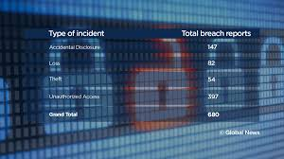
Mandatory Breach Reporting
Mandatory Notification and Reporting
Only with “Significant Risk”
  Bodily Harm;
  Humiliation;
  Damage to reputation or relationships;
  Loss of employment, business or professional opportunities;
  Financial loss;
  Negative impact on a credit record; or
  Damage to, or loss of, property

Slide 58
AP 1202:Critical Incident and Privacy Breach (Continued)
  Privacy Breach Response
  Privacy Officer will lead and coordinate the following steps
Contain
  Work with IT to contain the breach.
Investigate & Assess Risk
  Work with IT or engage 3rd party to do investigation to identify all PI that was breached
  Assess breached against the FIPPA Breach reporting guidelines
Notification & Report
  If breach is deemed to cause "significant harm", notifications are prepared and sent out to all individuals that were involved in the breach.
  Report the breach to the OIPC.
  (Notification to OIPC is done by the Privacy officer not by the person that initially experiences or reports the breach internally!)
Prevention
  Train & Educate Staff
    Training sessions
    Phishing campaigns
  Reduce sources of potential breaches (unneeded/overlapping software & services)
  Authentication & Password "hygiene"
    2 Factor Authentication
    Geo-fencing access to digital resources
    Do not use same password used for personal accounts
  Protect what you collect
    Ensure PI is stored in proper places (eg Sharepoint, and other secured locations)
    Avoid sending PI through email or sharing on non secured links in Google environment
  Develop Breach Response Plan
  Develop responsible retention practices
Notes:
Responsibilities of Staff
1.1 All Staff must without delay report all actual, suspected or expected Privacy
Breach incidents of which they become aware in accordance with this Procedure.
All Staff have a legal responsibility under FIPPA to report Privacy Breaches to the
Head.
1.2 Privacy Breach reports may also be made to the Privacy Officer, who has delegated
responsibility for receiving and responding to such reports.
1.3 If there is any question about whether an incident constitutes a Privacy Breach or
whether the incident has occurred, Staff should consult with the Privacy Officer.
1.4 All Personnel must provide their full cooperation in any investigation or response to
a Privacy Breach incident and comply with this Procedure for responding to Privacy
Breach incidents.
1.5 Any member of Staff who knowingly refuses or neglects to report a Privacy Breach
in accordance with this Procedure may be subject to discipline, up to and including
dismissal.

Slide 59
Administrative Procedures to Support FIPPA
AP 1202 - Critical Incident and Privacy Breach
AP 1203 - Use of Personal Devices for District Work
AP 1204 - Cell Phones & Personal Electronic Devices
AP 1206 - Student and Employee Personal Privacy on the Internet
AP 1207 - Advertising, Canvassing and Commercial Solicitation
AP 1209 - Return of School District Property
AP 1300 - Freedom of Information and Protection of Privacy
  Appendix 1300 A - Student Consent Freedom of Information Form
  Appendix 1300 B - Freedom of Information and Protection Act Fee Schedule
AP 1301 - Freedom of Information and Protection of Privacy Act Designation of Head
AP 1304 - Employee Records
AP 1305 - Data Retention
AP 1306 - Copyright
AP 1308 - Privacy Impact Assessments

Slide 60

Further Information & Online Training
Privacy Officer Contact
  250-352-6681
  Privacy@sd8.bc.ca
District Website
Policies and Administrative Procedures
OIPC
OIPC Guidance Documents
Online Training
FOIPPA Foundations Training

Slide 61
Health and Safety
New and Young Worker Orientation
Scott Rothermel (he/him/his)
Manager of Safe Schools & OHS
Notes:
Updated June 2020

Slide 62
SD8 Workplace Rules
Report accidents, injuries, or near misses
Wear PPE where required
Operate all vehicles and mobile equipment in accordance with rules and highway requirements.
Use tools in good condition, with all guards and appropriate safety devices
Theft, vandalism, or any other abuse or misuse of company property is prohibited
No fighting
Refrain from horseplay or practical jokes

Slide 63
Drugs and Alcohol
The use of drugs or alcohol on site is strictly prohibited
As a worker you must not enter or remain at any workplace while your ability to work is affected by alcohol, a drug or other substance (OHSR 4.20)
School District 8 reserves the right to remove from the site any person who is, or appears to be Affected by the side effects of drugs or alcohol
Notes:
4.20 Impairment by alcohol, drug or other substance
(1) A person must not enter or remain at any workplace while the person's ability to work is affected by alcohol, a drug or other substance so as to endanger the person or anyone else.
(2) The employer must not knowingly permit a person to remain at any workplace while the person's ability to work is affected by alcohol, a drug or other substance so as to endanger the person or anyone else.
(3) A person must not remain at a workplace if the person's behaviour is affected by alcohol, a drug or other substance so as to create an undue risk to workers, except where such a workplace has as one of its purposes the treatment or confinement of such persons.

Slide 64
Responsibilities - Workers
Follow any health and safety requirements
Ask for instruction if unsure in how to perform a task
Work safely, and encourage your co-workers to do the same
Report any unsafe conditions to your supervisor
Report any injury to the first aid attendant and your supervisor
Make suggestions to improve safety
Do not engage in horseplay or be impaired by alcohol, drugs or other causes
Notes:
In addition to SD8 Rules there are responsibilities laid out in the Workers Compensation Act for Workers Supervisors and Managers

Slide 65
Responsibilities – Supervisors
Instruct workers under your supervision and ensure their work is performed safely
Ensure compliance with WSBC and SD8 Requirements
Participate in accident investigations
Work with the local JHSC to improve safety
Set a good example as a Safety Leader

Slide 66
Responsibilities – Management
Provide a safe and healthy workplace
Ensure that workers are adequately trained
Provide Personal Protective Equipment where required by regulation and ensure they are used.
Establish and maintain a comprehensive occupational health and safety program
Work with the local JHSC to improve safety

Slide 67

Worker’s Rights
The Workers Compensation Act outlines three basic rights:
  Right to Refuse
  Right to Know
  Right to Participate

Slide 68
Right to Refuse
You have the right to refuse unsafe work if you have “reasonable cause” to believe the work will create an undue hazard to your safety or someone else's
If you are refusing unsafe work, you must report this to your supervisor immediately!
Notes:
unwarranted, inappropriate, excessive or Disproportionate = undue

Slide 69
Right to Know
All employees have a right to know what hazards they may encounter at work.
You will learn about the hazards at:
  This Health and Safety Orientation
  On the job instructions
  Various Training Sessions

Slide 70
Right to Participate
All employees have a right to be part of a health and safety program.
  *you can be chosen to be a health and safety representative
All employees also have the responsibility to report any unsafe conditions they encounter
  Remember you will not get in trouble for simply reporting unsafe conditions (unless you yourself created those conditions)

Slide 71
Joint Health and Safety
Committees (JHSCs)
JHSCs are a requirement for any site over a certain size.
Composed of both Management Representatives and Worker Representatives (from both unions)
Work to:
  Prevent accidents
  Discuss safety concerns from the workforce
  Recommend ways to improve safety at their site

Slide 72
Joint Health and Safety
Committees (JHSCs)
The minutes from at least the last three meetings will be posted on site
JHSC representatives are elected, and their contact information will be posted on-site.
JHSC representatives (after your supervisor) are a great point of contact for any safety concerns

Slide 73

Workplace Inspections
Routine Workplace Inspections are Conducted by the Joint Health and Safety Committee annually.
If a hazard is identified:
  report it to your supervisor and
  ensure that it is corrected promptly

Slide 74

First Aid
A current list of first aid attendants is available within the first aid room or at the office.
Any injury requiring first aid should also be reported to your supervisor.

Slide 75
Reporting Procedures
You must report any accident, incident, or near miss to your supervisor immediately.
The following types of incidents will need to be investigated and reported to WSBC (form 6A):
  Injuries requiring medical attention beyond first aid
  Injuries resulting in a day away from work
  Incidents with no major injuries but the potential to have caused a serious injury

Slide 76
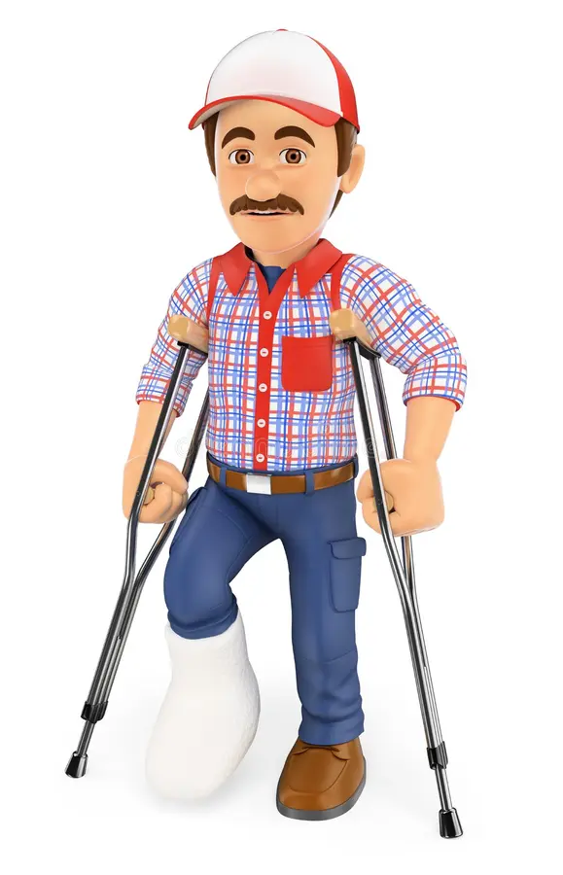
Injury Management / RTW
SD8 endeavors to facilitate early return to work or healing at work where practicable and will take efforts to accommodate temporary limitations or restrictions where feasible.

Slide 77
Emergency Procedures
LOCK DOWN
HOLD AND SECURE
Threat is External
Classes resume normal activity
Limited movement
Exterior doors are locked
Placards are placed on doors
Threat is internal
No classroom activity
No movement
Interior doors are locked
Exterior doors are left open

Slide 78



Slide 79
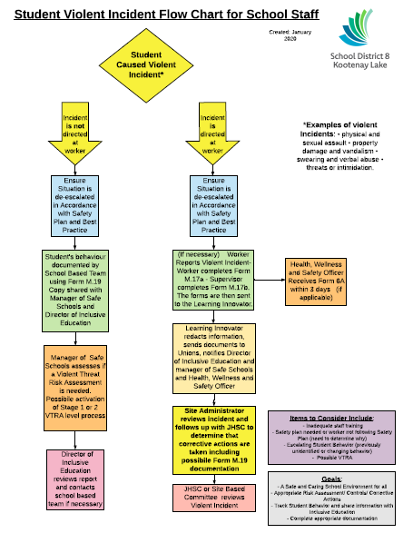

Slide 80
M.17a form for staff member
M.17b form for supervisor

Slide 81
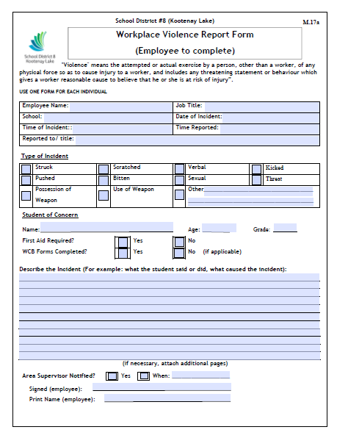

Slide 82
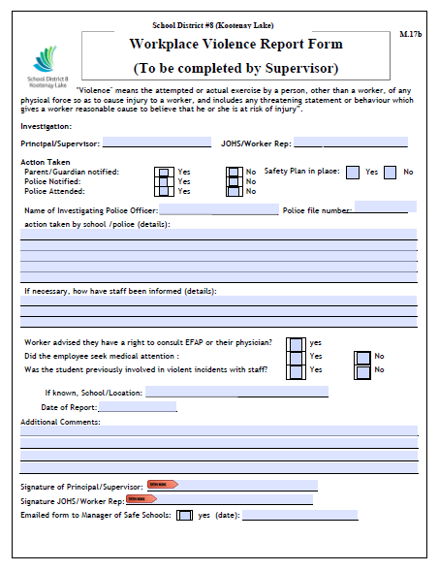

Slide 83

Mobile Equipment Operation
Working around mobile equipment can lead to serious injury or death if proper precautionary measures are not taken
Ensure eye contact with the operator before entering the area
Do not enter blind spots of mobile equipment while it is in operation
Equipment Operators have additional responsibilities around equipment operation and maintenance

Slide 84
W.H.M.I.S
Workers have a right to know:
  What hazardous ingredients they are likely to be exposed to on-the-job site
  What to do to protect themselves from those hazards
  Where to get additional information
SD8 has various chemicals and other controlled products you may encounter as part of your job.

Slide 85

W.H.M.I.S
In addition to training, the WHMIS system requires all controlled products:
  Be labeled with appropriate information
  have a material safety data sheet available for review
Current MSDSs will be available on site but their location may vary, please consult with your site administrator for more information. They are also available online.

Slide 86
Asbestos Awareness
Asbestos Awareness
Scott Rothermel
Manager of Safe Schools & OHS

Slide 87

Asbestos Awareness

Slide 88
Site Orientation
Includes:
  Facility Walk Through
  Review the Site Specifics
  Introduction to Supervisor / Contact Information
  Incident Reporting
  Bulletin Board
  First Aid Procedures

Slide 89
Site Orientation
Includes:
  Emergency Procedures
  Emergency exits / Muster Points
  Fire extinguisher locations
  Other emergency equipment
  Site Specific Hazards
  Student information such as: Safety Plans

Slide 90
Ask for Instruction
Always ask for instruction if you are unsure about how to perform a job safely
  Obtain both verbal instruction and physical demonstration where applicable
Ensure you understand the hazards and safety risks of any task you need to perform and how to control them

Slide 91


Slide 92
Scott Rothermel (he/him/his)
Manager of Safe Schools & OHS
safe.schools@sd8.bc.ca
250-551-3285

Slide 93
Smart Find Express (SFE) & Dispatch
Ellisha Macoretta
tabsence@sd8.bc.ca
Notes:
Updated June 2020

Slide 94
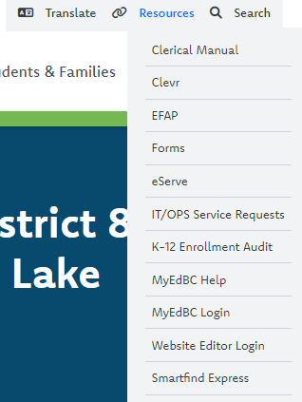
WEB BROWSER ACCESS
LOG IN
The link to SFE can be accessed by navigating to the RESOURCES dropdown menu located at the top right of the SD8 website.
Notes:
This is the same log in for your SD8 email, office 365 .
You can use the forgot my password link to reset your password or contact IT at helpdesk.bc.ca

Slide 95
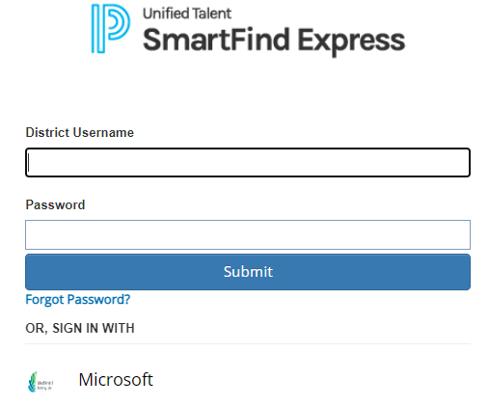
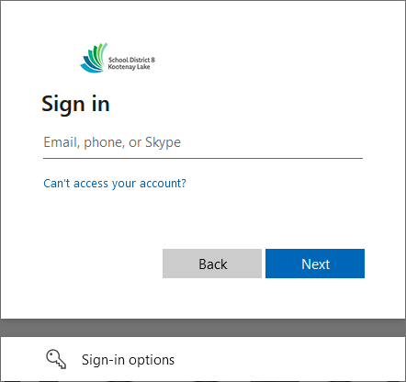
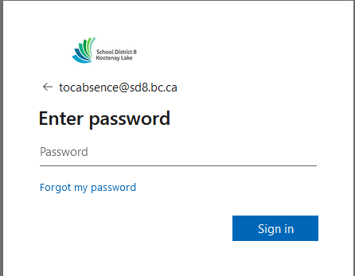
WEB BROWSER ACCESS
LOG IN
From the Smartfind Express login page, click the SD8/Microsoft sign in button and sign in using your SD8 email and password.
Notes:
This is the same log in for your SD8 email, office 365 .
You can use the forgot my password link to reset your password or contact IT at helpdesk.bc.ca

Slide 96
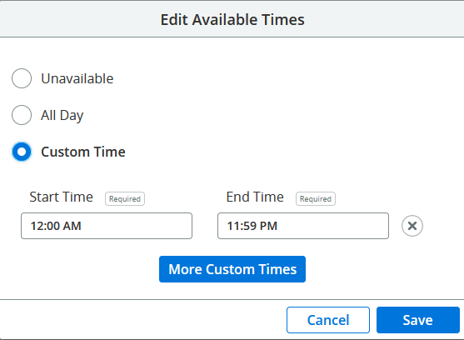
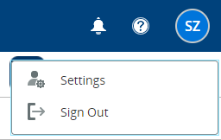
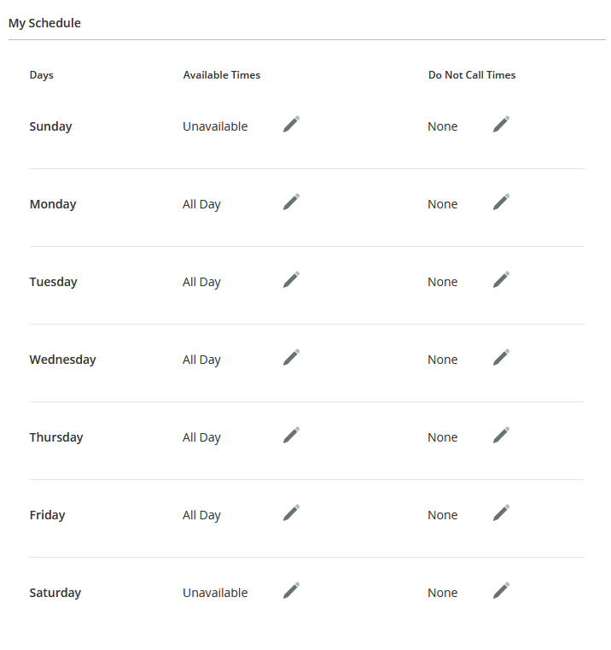
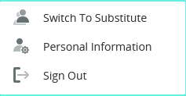
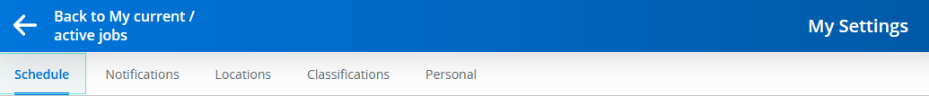
WEB BROWSER ACCESS
PROFILE SETTINGS- Substitute
Navigation Steps:
Select your initials on the top right of the screen.
1
1
2
2
Select “Settings”
Schedule Configuration Steps:
1
Select “Schedule”
1
For each day of the week, click Edit (pencil) to define Available
Times and Do Not Call Times.
Click All Day, Unavailable, or Custom.
If custom, enter Start Time and End Time.
Click Save.
Notes:
This is the same log in for your SD8 email, office 365 .
You can use the forgot my password link to reset your password or contact IT at helpdesk.bc.ca

Slide 97
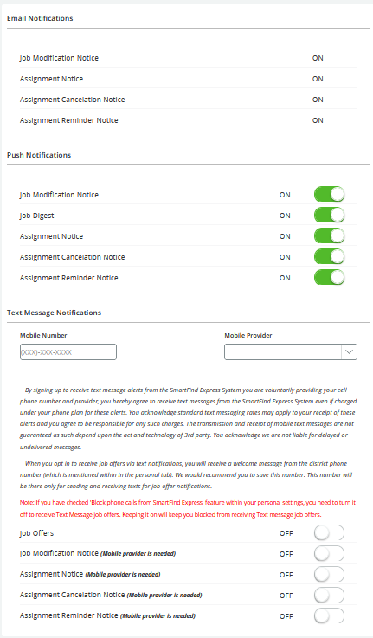
WEB BROWSER ACCESS
PROFILE SETTINGS- Substitute
Navigation Steps:
1
1
Select your initials on the top right of the screen.
2
2
Select “Settings”
Notifications Configuration Steps:
1
Select “Notifications”
1
Turn notifications on or off for email, push (in-app), and SMS (text) delivery.
If you elect to receive SMS notifications, enter Mobile Number and select Mobile Provider.
Mobile App District Code: SBDM
Notes:
This is the same log in for your SD8 email, office 365 .
You can use the forgot my password link to reset your password or contact IT at helpdesk.bc.ca

Slide 98
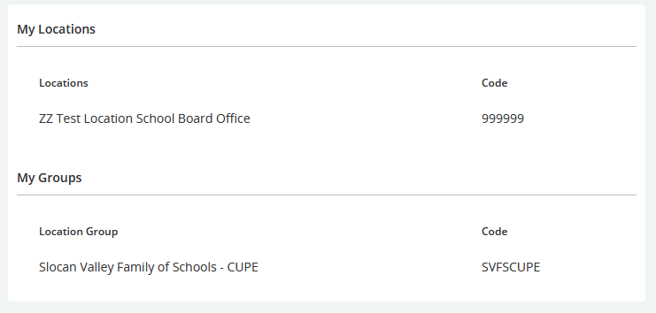
WEB BROWSER ACCESS
PROFILE SETTINGS- Substitute
Navigation Steps:
1
1
Select your initials on the top right of the screen.
2
2
Select “Settings”
Locations Configuration Steps:
1
Select “Locations”
1
The locations you selected on your Make a Future application will be displayed in this section. If you would like to add or remove a location from your profile, please contact the SFE Operator at tabsence@sd8.bc.ca.
Notes:
This is the same log in for your SD8 email, office 365 .
You can use the forgot my password link to reset your password or contact IT at helpdesk.bc.ca

Slide 99
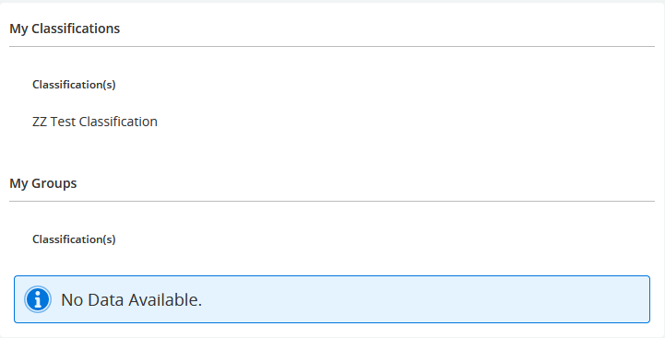
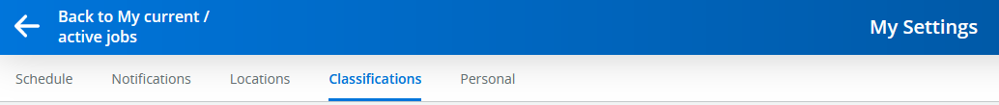
WEB BROWSER ACCESS
PROFILE SETTINGS-Substitute
Navigation Steps:
1
1
Select your initials on the top right of the screen.
2
2
Select “Settings”
Classifications Configuration Steps:
1
Select “Classifications”
1
The qualified classifications will be displayed in this section. If there are any discrepancies in this section, please contact the SFE Operator at tabsence@sd8.bc.ca
Notes:
This is the same log in for your SD8 email, office 365 .
You can use the forgot my password link to reset your password or contact IT at helpdesk.bc.ca

Slide 100
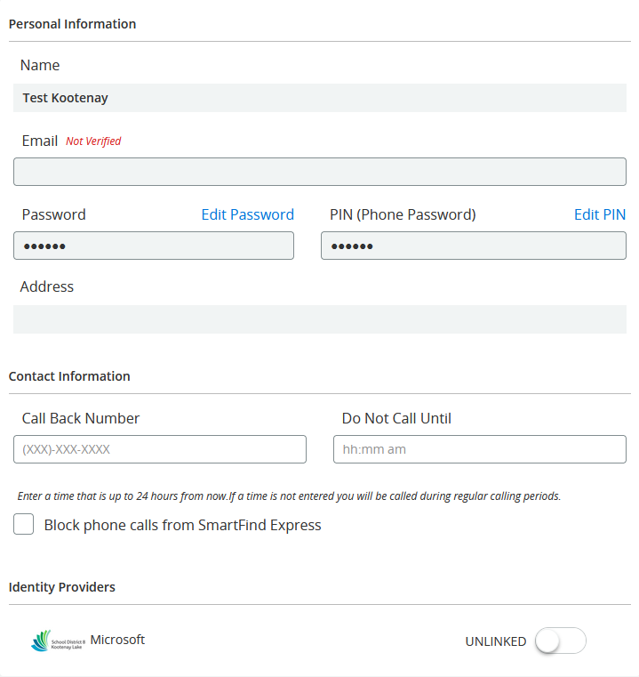
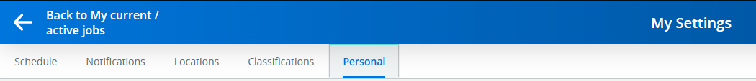
WEB BROWSER ACCESS
PROFILE SETTINGS- Substitute
Navigation Steps:
1
1
Select your initials on the top right of the screen.
2
2
Select “Settings”
Personal Configuration Steps:
1
Select “Personal”
1
Please be sure that your callback number is accurate and up to date as this is what the system will be using for available assignments.
Notes:
This is the same log in for your SD8 email, office 365 .
You can use the forgot my password link to reset your password or contact IT at helpdesk.bc.ca

Slide 101
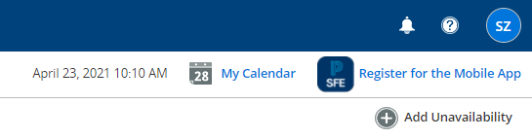
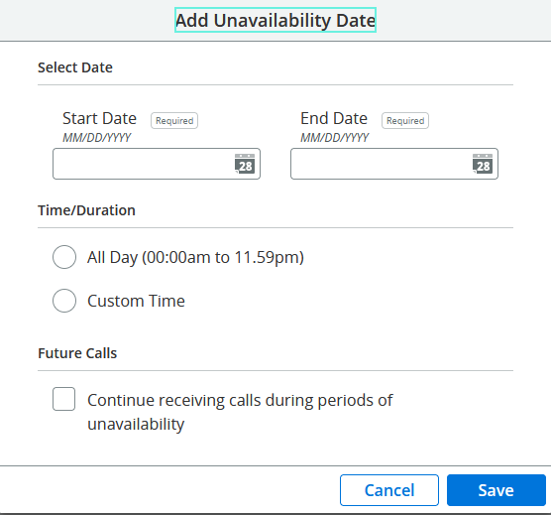
WEB BROWSER ACCESS
UNAVAILABLE DATES
Navigation Steps:
1
Select the Add Unavailability icon on the right side of your profile page.
2
Select a date range by navigating to the calendar icon.
3
Select the Time/Duration
4
Select Continue receiving calls during periods of unavailability in order to continue to be notified of future job offers.
5
Select “Save”, and your unavailability will be saved!
Notes:
This is the same log in for your SD8 email, office 365 .
You can use the forgot my password link to reset your password or contact IT at helpdesk.bc.ca

Slide 102
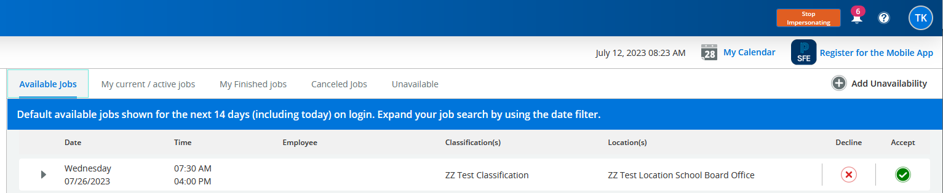
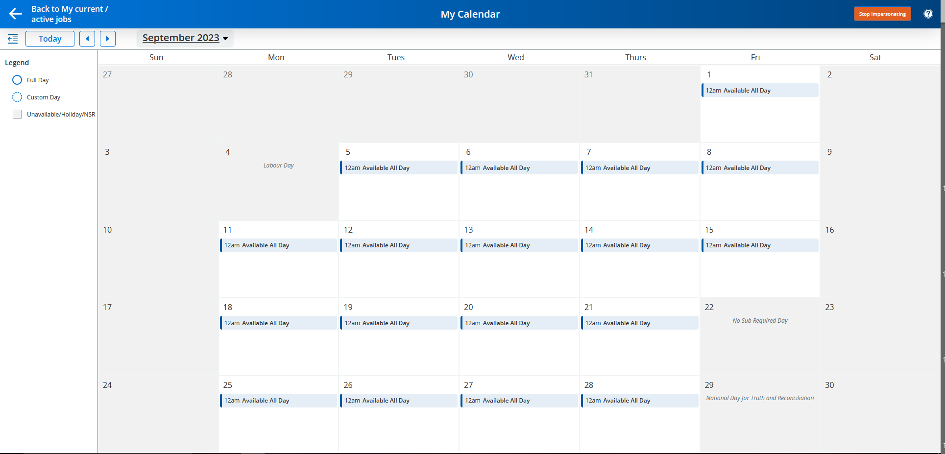
WEB BROWSER ACCESS
ACCEPTING A JOB
1
All available jobs will be displayed upon sign in under the Available tab.
2
If you want more information about a job, just hit the down arrow.
3
Once you decide to accept the job, you can tap the green checkmark under “Accept”, and you will have accepted the job.
4
You can view your Active Jobs from your Calendar my selecting the My Calendar button or the My current/active jobs section.
Notes:
This is the same log in for your SD8 email, office 365 .
You can use the forgot my password link to reset your password or contact IT at helpdesk.bc.ca

Slide 103
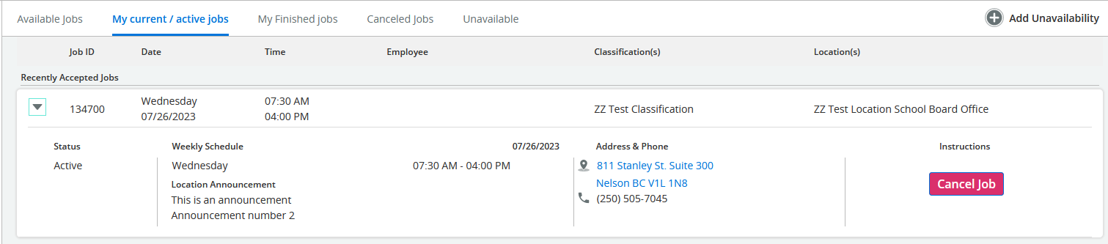
WEB BROWSER ACCESS
ACCEPTING A JOB
1
When in my current/active jobs section, you can cancel out of job within 24 hours of the start time.
2
Select the down arrow and the cancel job option will appear.
Notes:
This is the same log in for your SD8 email, office 365 .
You can use the forgot my password link to reset your password or contact IT at helpdesk.bc.ca

Slide 104
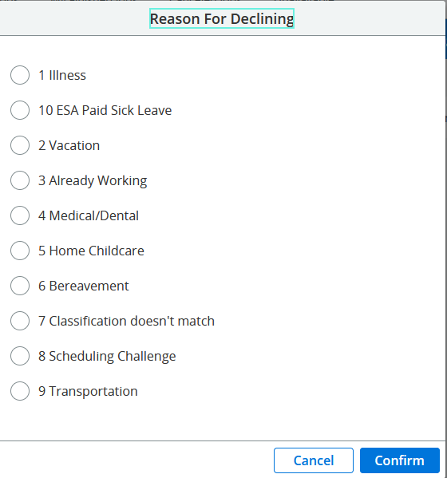
WEB BROWSER ACCESS
DECLINING A JOB
1
If you decide to decline a job, you must select a reason from the acceptable options and select confirm.
TTOC’s: 5 hang ups, 5 no answers and 1 decline with reason are allowed before the system will stop calling.
Notes:
This is the same log in for your SD8 email, office 365 .
You can use the forgot my password link to reset your password or contact IT at helpdesk.bc.ca

Slide 105
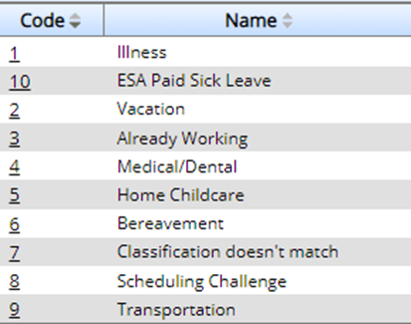
PHONE ACCESS
ACCEPTING/DECLINING A JOB
Enter ACCESS ID (Employee #) followed by the star (*) key.
Enter Pin # followed by the star (*) key.
PRESS 1 to Hear the job offer
PRESS 2 to Set temporary Do Not Call
If you pressed 1 to Hear the job offer:
  PRESS 1 to Hear the job description
  PRESS 2 to Decline the job (without hearing the description)
  Enter the decline reason from page 1 followed by the star (*) key
If you pressed 1 to Hear the job description:
  PRESS 1 to Accept this job
  Record the Job Number. You are successfully assigned to the job.
PRESS 2 to Repeat the job description
PRESS 3 to Decline the job
  Enter the decline reason from page 1 followed by the star (*) key
  PRESS 1 to Accept
If you pressed 2 to Set temporary Do Not Call, hear a time offered:
  PRESS 1 to Accept the time offered
  PRESS 2 to Enter an earlier time in HH:MM format.
ACKNOWLEDGING A CANCELLED JOB VIA THE TELEPHONE :
When a job is cancelled, the system may call to notify you of the cancellation.
Enter ACCESS ID (Employee #) followed by the star (*) key.
Enter Pin # followed by the star (*) key.
Press 1 to accept the cancellation
Notes:
This is the same log in for your SD8 email, office 365 .
You can use the forgot my password link to reset your password or contact IT at helpdesk.bc.ca

Slide 106
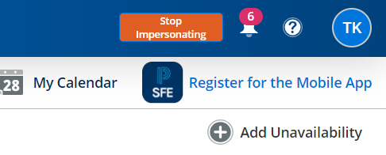
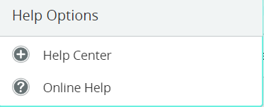
SFE HELPDESK
1
Navigate to the question mark icon on your profile page and select online help from the pop-up window.
1
2
Contact the SFE System Operator:
tabsence@sd8.bc.ca
250-505-7065
Notes:
This is the same log in for your SD8 email, office 365 .
You can use the forgot my password link to reset your password or contact IT at helpdesk.bc.ca

Slide 107
Payroll Contact information
  Teacher/TTOC/Excluded staff Payroll
    Shauna Martens – Manager of Payroll & Benefits
    payroll@sd8.bc.ca
    teacher.payroll@sd8.bc.ca
  CUPE/Support staff Payroll
    Ancilin Shaji – cupepayroll@sd8.bc.ca

Slide 108
Payroll Information
TTOCs receive an advance (no deductions) based on dates worked from the 1st to the 15th monthly (calculated at an estimated 50% of net at month end), paid five business days after the 15th. Month-end pay is issued five business days after the last day of the month. Pay slips are emailed to district accounts for review and we are happy to assist with inquiries.
Rosanne Winter (TTOC Payroll):
teacher.payroll@sd8.bc.ca

Slide 109
Teachers are paid a fixed advance (estimated at 40% of month end) on the 13th, monthly. Month-end deposit is two business days before month end.
Term and Continuing Teachers have the option to enroll for the Teacher Savings Plan, annually. The form must be returned to payroll by mid-September. Estimated at 1/6th of monthly net pay, withheld after deductions, and included on the final June pay, or can be issued for deposit on July 15th and August 15th.
Shauna Martens (Teacher/Admin Payroll/Benefits):
payroll@sd8.bc.ca

Slide 110
CUPE Payroll is bi-weekly. Cut off is Saturday with the deposit the following Friday. Hours are submitted to payroll through eServe timesheets (electronic) for regular and temporary employees and paper timesheets for casuals (available at all sites and on the District website).
Click to view the current CUPE bi-weekly pay schedule
Ancilin Shaji (CUPE Payroll/Benefits):
cupepayroll@sd8.bc.ca

Slide 111
Benefit Information
Teachers with a 0.5 FTE or higher are eligible for benefit coverage at a shared cost, details under Article B.11 in the KLTF Collective Agreement.
Application forms will be emailed to employees when eligible for coverage.
TTOCs can access benefit plans (Dental & Extended Health) at 100% employee cost, details under Article B.2. Please inquire if interested.
CUPE benefits are available for regular positions over 17.5 hours/week at 100% employer cost, details under Article 15 in the CUPE Collective Agreement. Application forms will be emailed to employees when eligible for coverage. Casual and Temporary employees get paid in lieu of benefits.
Additional Resource:
Education and Youth and Family Worker Handbook

Slide 112
New CUPE Staff – Make a Future
Next steps to finish setting you up as an SD8 employee:
You will be made an internal employee
Apply to CUPE Call Out Registration (internal posting)
PIN Memo
Change Make a Future email address to SD8 email

Slide 114
Welcome to School District #8
and thank you for your commitment in working with our students!
https://www.sd8.bc.ca

